Slide 1
Insurance CLAIM PREDICTION
PRESENTED BY SAHIL MALEK

Slide 2


CONTENTS
Introduction
Problem Statement
Objective of Project
Coding Environment and language
Dataset and Algorithms
Data cleaning and its pre-processing
EDA with Charts and plots
Model development , Implementation and testing
Outcomes and Conclusion

Slide 3
INTRODUCTION
In today's highly competitive business landscape, understanding customer or client behavior is crucial for success. Insurance claim data refers to the records of requests made by policyholders to an insurance company for compensation or coverage of specific losses, damages, or expenses as defined by their insurance policy. This data includes details such as the policyholder's information, type of claim, date of the incident, amount claimed, and the status of the claim. Analyzing this data helps insurance companies assess risk, detect fraud, and improve their services.

Slide 4
PROBLEM STATEMENT
Insurance claims often face delays due to bureaucratic inefficiencies and incomplete documentation.
Claims can be denied if the incident falls under policy exclusions.
Investigating potential fraud further slows down the process, and poor communication between insurers and claimants can lead to misunderstandings and additional delays.

Slide 5
Objective of the project
The objective of an insurance claim is to provide financial protection and compensation to policyholders for covered losses or damages.
It ensures that individuals or businesses can recover from unforeseen events without bearing the full financial burden.
Insurance claims help maintain financial stability by covering costs such as medical expenses, property damage, or liability.
They also offer peace of mind, knowing that there is a safety net in place.
Ultimately, the claim process is designed to fulfil the promise made by the insurer to support the policyholder in times of need.

Slide 6
Dataset and algorithms
This dataset contains comprehensive information on insurance data and behaviour, it contains policy details, claim amounts and dates. It includes customer demographics, This data is used to analyze and predict risks, detect fraud and improve claims processing efficiency.
Age: Number of ages of customer or policy holder or a individual filing the claim.
Bmi: Body Mass Index (BMI) used to access weight and height to evaluate health risks
Insurance Claim: It includes records of incidents where the policy holder request compensation from their insurance provider
Children’s: Dependents covered under a policy such as minors who are beneficiaries of health or life insurance.
Sex: Gender of policy holders and claimant such as male, female, others
I have used Decision Tree Classifier, Random Forest and Linear Regression, SVM.

Slide 7
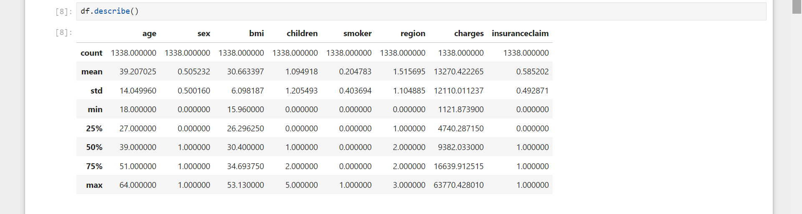
Data cleaning and its pre-processing
Data cleaning and its pre-processing plays and important role in data analytics process.
I have 1338 rows and 8 columns in my dataset and I have cleaned and pre-processed my dataset.
After cleaning and pre-processing my data looks like the given image below.

Slide 8
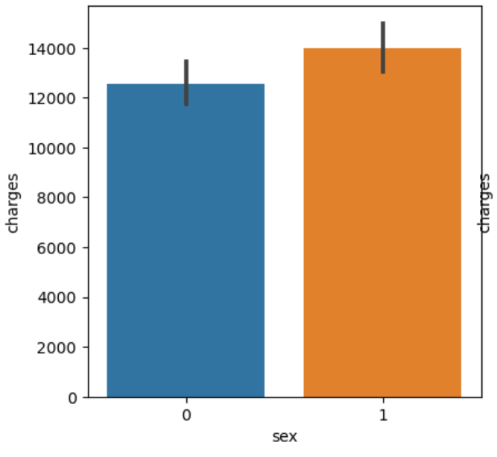
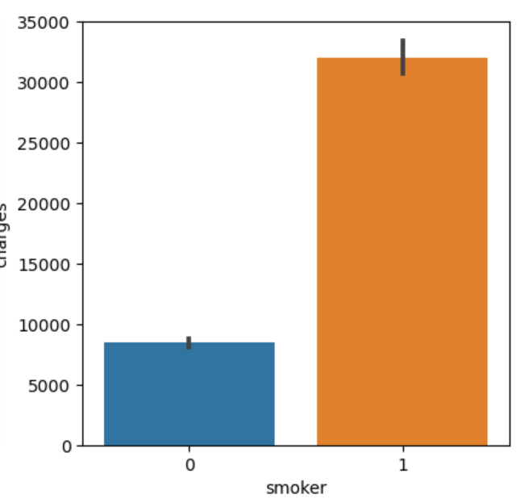
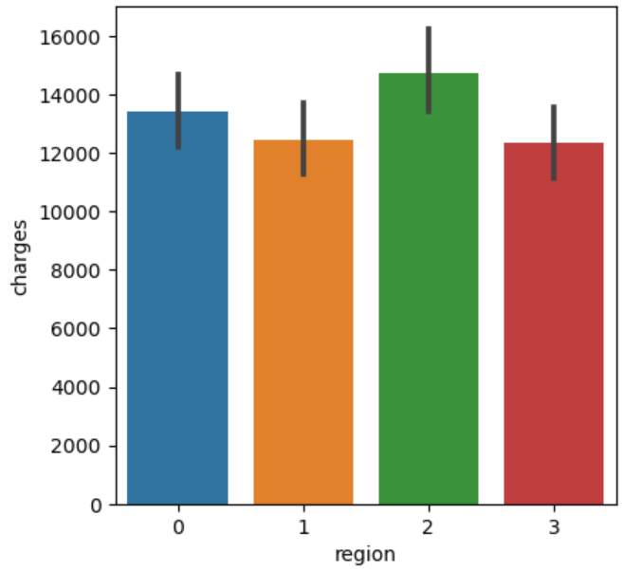
EDA with charts and plots bar plot

Slide 9
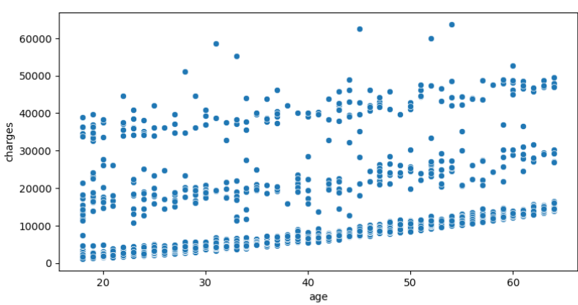
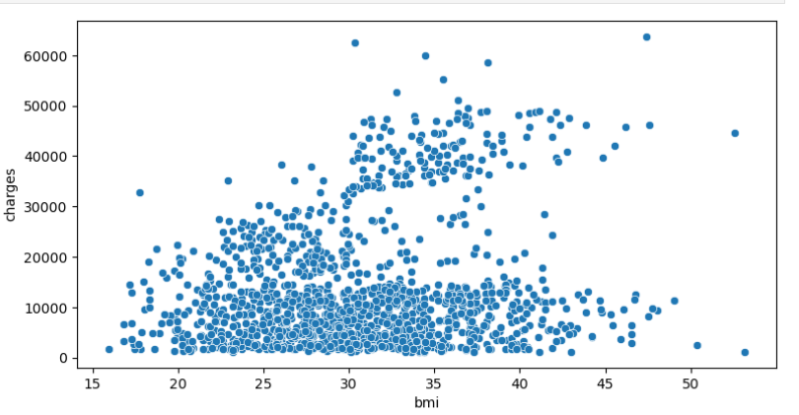
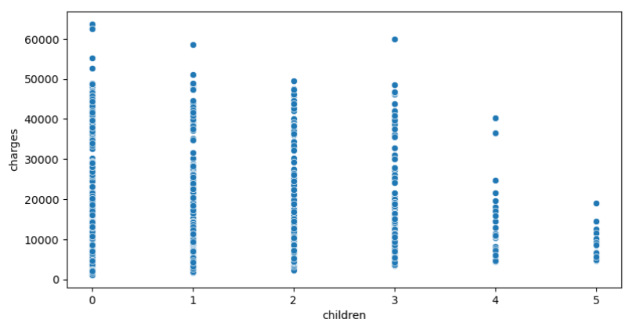
Eda with charts and plots scatter plot map

Slide 10
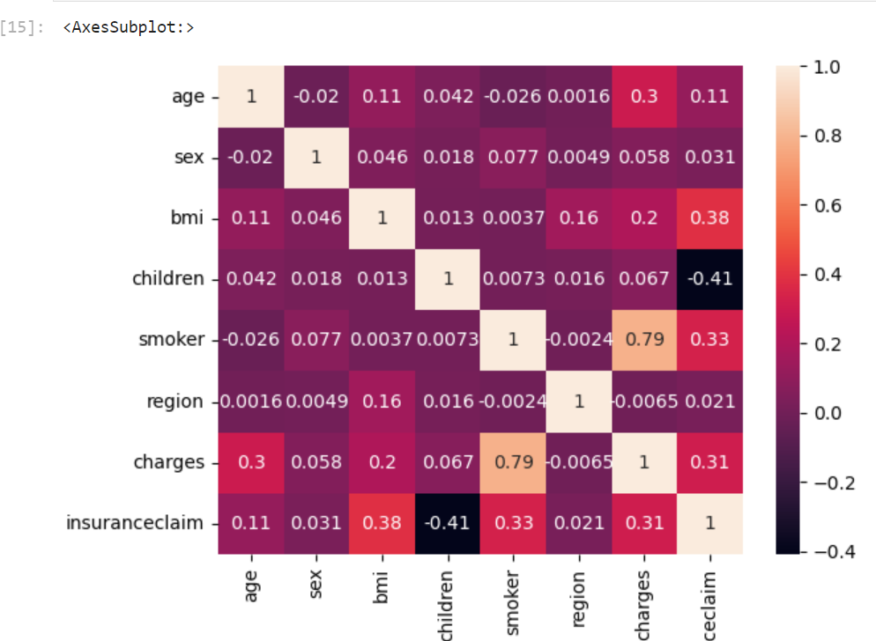
Eda with charts and plots (Heat map)

Slide 11
Model development implementation and testing
Decision Tree Classifier:
Accuracy: 0.98, Precision: 0.99 , Recall: 0.98, F1 Score: 0.99
Linear Regression:
MSE for linear regression : 0.14 R2 Score :0.41
Support Vector Machine:
MSE : 0.28 R2 Score : -0.15

Slide 12
conclusion
This study aims to showcase the tool, techniques and methodologies of Data Analytics in upgrading the quality and visibility of the predict the insurance claim and risk factors patterns of claims behaviour and effectiveness of fraud detection measures enhance the customer satisfaction and optimize their business processes

Slide 13
THANK YOU
SAHIL MALEK
sahilmalek2378@Gmail.com
+91 9510045859
https://www.linkedin.com/in/sahil-malek-1834071ab

